Slide 1
A Survey of South American Lizards Biodiversity and Ecological

Slide 2
Abstract
South America boasts a diverse range of lizard species, contributing significantly to the continent's biodiversity. This research paper aims to provide an overview of various South American lizard species, their unique characteristics, habitats, and ecological importance.

Slide 3
Biodiversity and Distribution of South American Lizards
South America is home to a diverse range of lizard families, each with its unique characteristics and adaptations to the various habitats found across the continent.

Slide 4
Iguanidae
The Green Iguana is one of the most wellknown lizards in the region. Iguanidae includes a variety of species.

Slide 5
Teiidae
Teiidae is commonly referred to as "whiptails" or "racerunners." These lizards are known for their slender bodies, long tails, and quick movements.

Slide 6
Gymnophthalmidae
3 Gymnophthalmidae This family is composed of small, slender lizards often found in forested regions. They are characterized by their reduced limbs and elongated bodies, and they play essential roles in insect control within their ecosystems.

Slide 7
Gekkonidae
Geckos are nocturnal lizards with adhesive toe pads. The Gold Dust Day Gecko is a species found in South America.

Slide 8
Sphaerodactylidae
5. Sphaerodactylidae The Sphaerodactylidae family consists of small geckos known as \"dwarf geckos.\" These miniature lizards are often found in leaf litter and rocky areas, displaying a remarkable range of coloration and patterns.

Slide 9
Dactyloidae
Anoles are members of the Dactyloidae family. Several species inhabit South America. They are characterized by their ability to change color.

Slide 10
Leiosauridae
7. Leiosauridae This family comprises various \"perching lizards\" found across South America. They are typically diurnal and often seen basking in the sun on rocks and branches.

Slide 11
Polychrotidae
The continent of South America is home to numerous lizard species. These lizards are part of several distinct families. Each family plays a unique ecological role in its respective habitat.

Slide 12
Representative Species
Representative Species Describe notable lizard species from different families found in South America, including but not limited to the following examples:

Slide 13
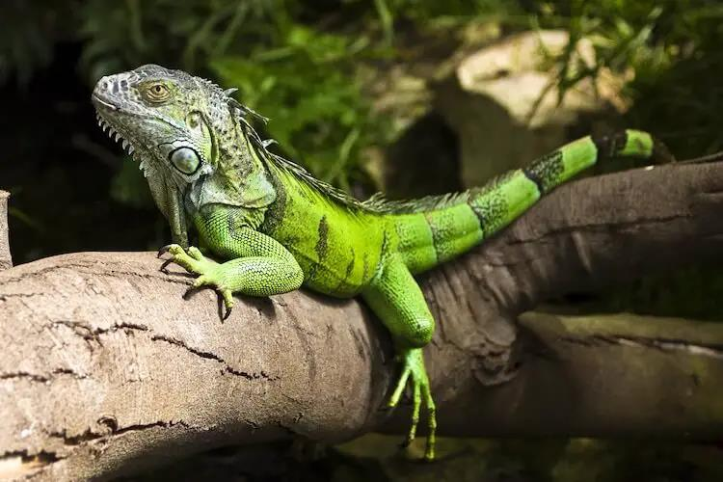

Slide 14
Green Iguana (Iguana iguana)
The Green Iguana is a large lizard species found in Central and South America. It is known for its vibrant green coloration and spends much of its time in the treetops. The Green Iguana faces conservation concerns due to habitat loss and poaching.

Slide 15
Caiman Lizard (Dracaena guianensis)
The Caiman Lizard is a captivating reptile native to South America. It possesses a unique set of features, making it stand out among its lizard counterparts.

Slide 16
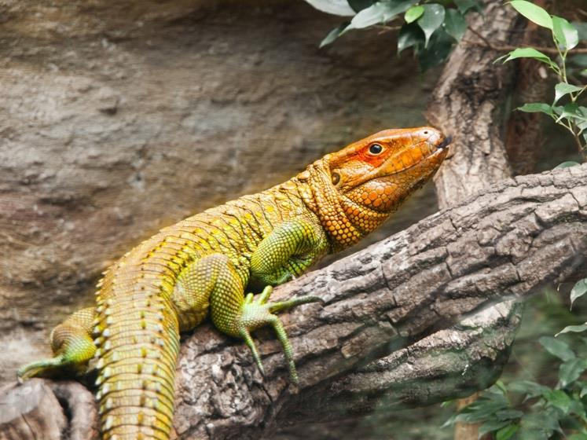

Slide 17
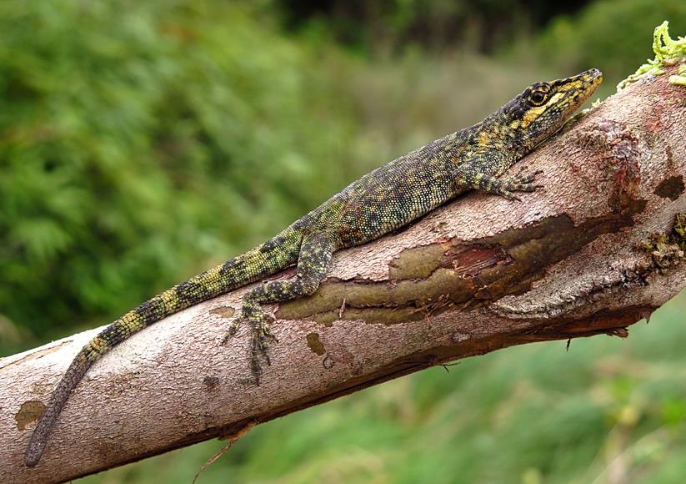

Slide 18
Tepui Lizard (Pristidactylus urichi)
The Tepui Lizard is a unique reptile found in the isolated and rocky habitats of the Tepui plateaus in South America. They are insectivorous and have developed remarkable adaptations to their specific environment. Despite their intriguing characteristics, the Tepui Lizard remains relatively understudied.

Slide 19
Threats and Conservation
The Green Iguana, Caiman Lizard, and Tepui Lizard are among the most captivating species of lizards in South America. These lizards face various threats, including habitat loss, illegal pet trade, and climate change. Conservation efforts are crucial to ensure their survival and wellbeing, involving protected areas, responsible pet ownership, and minimizing pollution.

Slide 20
Ecological Roles
South American lizards play various ecological roles in their respective habitats, including insect control, seed dispersal, and serving as a vital link in the food chain.

Slide 21
Conclusion
South American lizards are a diverse group of reptiles that play critical roles in their respective ecosystems. They face numerous threats, such as habitat loss, climate change, and illegal trade, which necessitate urgent conservation efforts.

